Slide 1
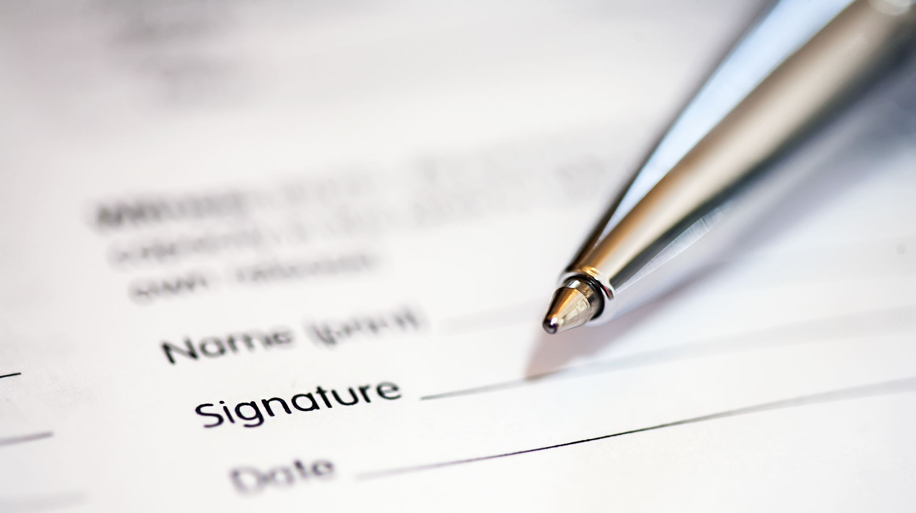
Legal Analysis cont. & Introduction to Bluebook Citation

Slide 2
Today in LSS
Jalen Fox Character and Fitness Analysis
- Rule Statement Practice
- Mustafa and Sobin Case Comparisons
- Where does Fox fit?
Law Firm 4 [Name?] Image Presentations
Introduction to Legal Citation
Don’t forget:
- Mandatory Legal Research Lab Today, 12:00-12:50, Room 102A (overflow 210)
-Complete Legal Research Modules 0.1-0.4 by 5:00 p.m. Today

Slide 3

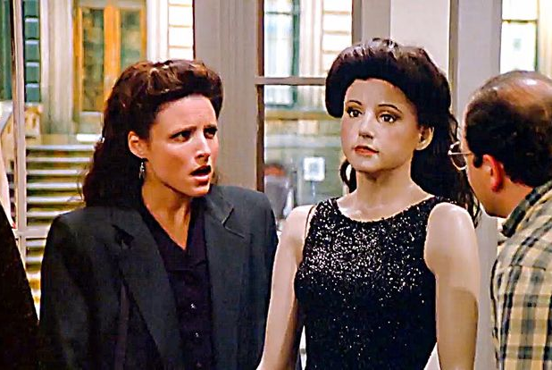
Trey Gaw

Slide 4

Milwaukee, WI –Promise Maduka

Slide 5
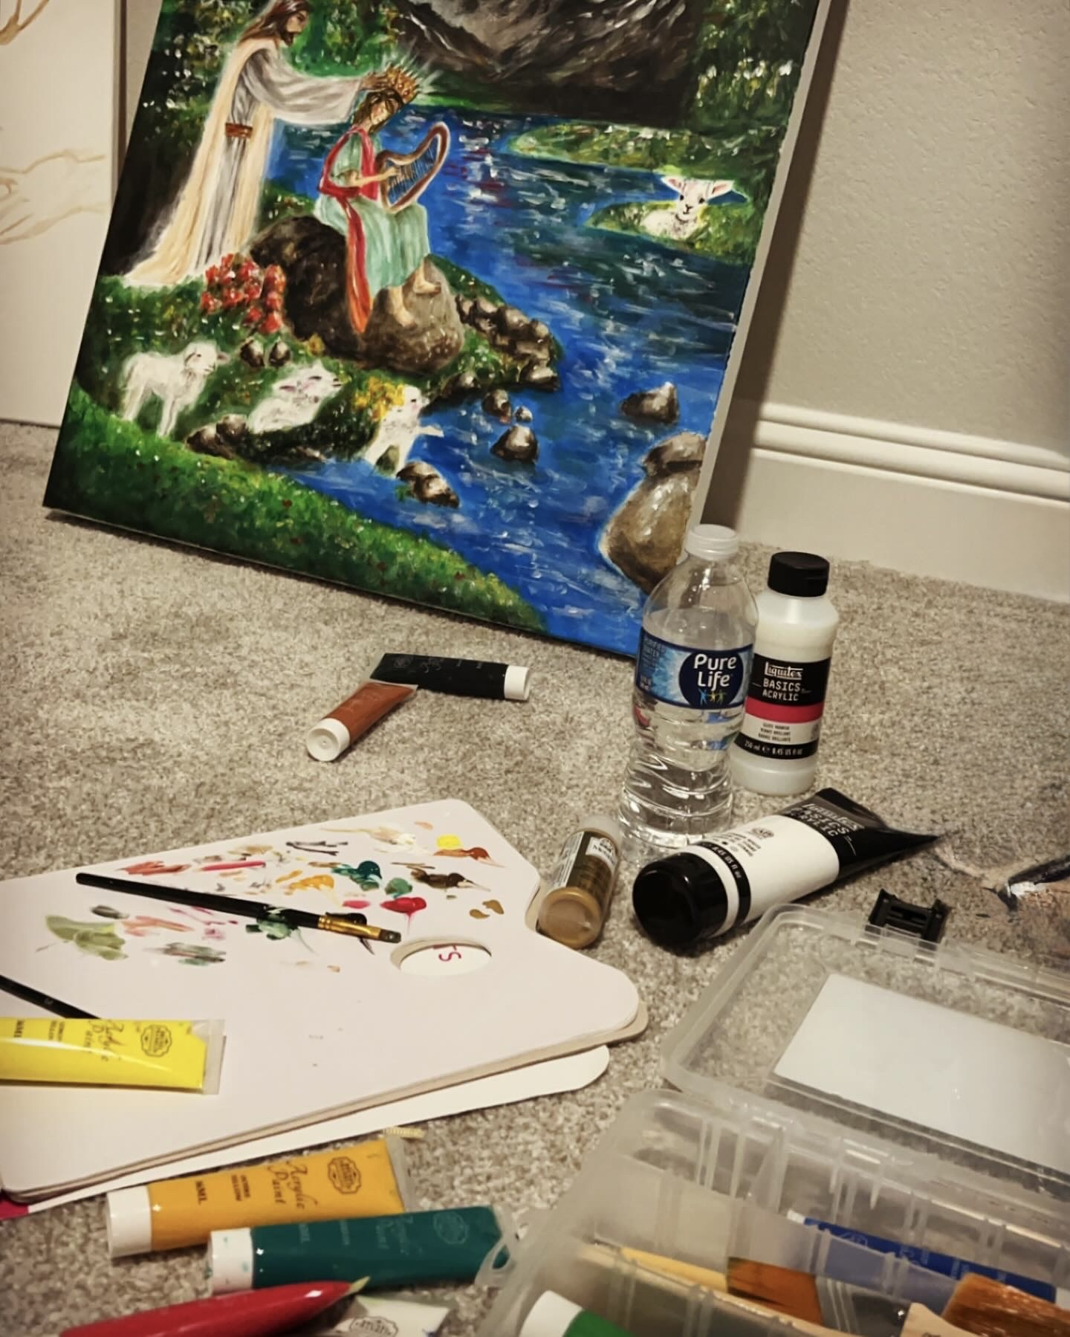
Joyclin Ranjith
Creating: Turning ideas into art
Competitive: Challenging myself
Flow: Fully immersed
Passionate: Persevering through limits
Faith: Creating with purpose

Slide 6
Legal Analysis: IRAC
Either rule-based or based on prior cases
Issue
Rule
Application
Conclusion
    Identify the QUESTION you must answer
Find the law that governs HOW you answer the question
APPLY that law (the rules) to your facts
    Predict the answer to your question
Notes:
THIS IS WHY WE BRIEF CASES TO TRACK THESE SAME TOPICS

Slide 7
Rule Statement Exercise
Complete the Following Character & Fitness Rule Statement from Mustafa and Sobin:
To gain admission to the D.C. Bar, an applicant must demonstrate by clear and convincing evidence that he possesses good moral character and general fitness to practice law in the District of Columbia at the time of admission._________________________________._____________________________________
Provide the next 2-3 sentences to complete; first on a Word document alone (your own work; No GenAI) (5 mins.); and then get into your law firms and pick the best answer (10 min.)
Your sentences should include the test the court (remember the reading quiz) applied to consider and the key factors that the Mustafa and Sobin courts considered important in deciding admission.
Adhere to these Rules Statement principles:
  Proceed from general to specific
  Write in the present tense
  Include a neutral statement of law (do not include facts from Fox, Mustafa, or Sobin).
  Do not worry about citation yet.
Upload your firm’s answer into the class discussion –Character & Fitness Rule Statement Discussion in the Week 2 Module. I should receive four separate responses. One from each firm. The submission are
We will review one or two submissions in class to see how we did.

Slide 8
Sample Rule Statement
To gain admission to the D.C. Bar, an applicant must demonstrate by clear and convincing evidence that he possesses good moral character and general fitness to practice law in the District of Columbia at the time of admission. D.C. App. R. 46(e); In re Mustafa, 631 A.2d 45, 47 (D.C. 1993). Any one incident is not controlling in the determination of qualification for admission. In re Sobin, 649 A.2d 589, 591 (D.C. 1993). Rather, the courts consider the totality of circumstances. Id. Key factors include the type of misconduct, the length of time since the misconduct, any positive personal achievements or charter references since the misconduct, and whether that misconduct occurred prior to the applicant entering law school. In re Mustafa, 631 A.2d at 47-48; In re Sobin, 649 A.2d at 591-92.

Slide 9
Charting the facts/factors of a Case
Jalen Fox Analysis Continued

Slide 10
Mustafa and Sobin Case Comparison Chart
Case & Citation | Type of Misconduct | Time since Misconduct | Prior to Law School? | Positive Personal Developments/Character References | Admitted?
In re Mustafa, 631 A.2d 45 (D.C. 1993) | Embezzlement – law school moot court team funds | 2.5 years | No, in 3L year law school; do not know age. | Full restitution, law professor and law firm references, ooperated with admissions committee, married, volunteered | No
In re Sobin, 649 A.2d 589 (D.C. 1994 | Aiding and abetting prostitution & transportation in the aid of racketeering (illegal drugs) | 9 – 12 years | Yes, teenage years | Clerked for his convicting judge and the office of bar admission counsel. | Yes
In re Polin, 630 A.2d 1140 (D.C. 1993) | Cocaine distribution | 6.5 years | ? | ? | Yes
Jalen Fox

Slide 11

INTRODUCTION TO
Legal Citation
With thanks to Professor Kate Brem for her essay, An Introduction to Legal Citation: A foundational guide to citation literacy.

Slide 12

Interactive Citation Workstation Exercises
Be sure to sign-up for our class on Lexis – Student Guide on Canvas in the Student Resources Module
Exercises 1 & 2 due on this Sunday, 9/6 at 5 PM
  Modified Instructions
Extra office hours for citations on Friday, 2 PM Zoom link to come; practice in groups

Slide 13



What Is a Citation?
Legal citation is the system lawyers and judges use to identify and refer to legal authorities. It tells your reader where to find a source — and communicates important information about it along the way.
Without an address
"Meet me at Jamie's house." Your friend has no way to find it.
With an address
"123 Oak Street, Houston, TX." Now they can get there themselves.
A legal citation works the same way. It gives your reader the address needed to find the case, statute, or other authority for themselves — and, once you learn to read it, tells you something about the authority before you ever retrieve it.
2

Slide 14
The Anatomy of a Citation
Gen. Motors Corp. v. Grizzle, 642 S.W.2d 837, 844 (Tex. App. 1982).
Case Name
Volume
Reporter
Identifies the parties involved in the case
The volume number of the reporter it appears in
The published series — here, South Western Reporter, 2d
First Page
Pin Cite
Parenthetical
The page on which the case begins
The specific page being referenced (a pinpoint citation)
Court, year, and history of the case
3

Slide 15
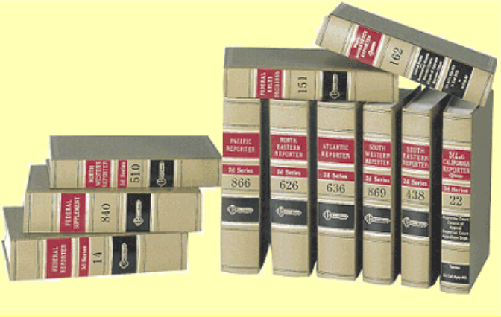
THE REPORTER SYSTEM
What Is a Reporter?
Court decisions have traditionally been published in books called reporters — collections of judicial opinions selected for publication. Cases are added roughly in the order they are decided, not by subject matter, so a reporter is not like an encyclopedia you can browse by topic.
Each published case gets an "address" based on where it sits in a particular reporter.
volume + reporter + page
642 S.W.2d 837 → page 837, volume 642, South Western Reporter, 2d
Reporters, shelved in decision order
4

Slide 16

THE REPORTER SYSTEM
Star Pagination
Lawyers usually retrieve cases electronically today — but citations are still keyed to the printed reporter’s page numbers. Electronic databases bridge the gap with star pagination: a marker embedded in the text shows exactly where a new printed page begins.
...ran closer toward the crashed vehicles, she could clearly perceive the results of the accident. She began to scream and fainted, hitting her head on the road. When she regained consciousness, she attempted to go to the collision because she heard her daughter screaming and saw *844 her coat smashed against the truck window...
The asterisk is a database marker — you do not include the star in your citation.
Everything after *844 falls on page 844 of the printed reporter — giving you an accurate pinpoint citation to a page you may never physically hold.
6

Slide 17


READING A CITATION
What Can a Citation Tell You? — Federal Courts
U.S.
F. / F.2d / F.3d / F.4th
F. Supp. / 2d / 3d
United States Reports
Federal Reporter
Federal Supplement
U.S. Supreme Court decisions only.
U.S. Courts of Appeals. Parenthetical names the circuit and year.
U.S. District Courts (federal trial courts).
Free Speech Coal. v. Paxton, 606 U.S. 461 — (2025)
Tex. Med. Ass’n v. United States Dep't of Health & Hum. Servs., 110 F.4th 762 (5th Cir. 2024)
Bazzrea v. Mayorkas, 677 F. Supp. 3d 651 (S.D. Tex. 2023)
7

Slide 18

READING A CITATION
State Courts & the Regional Reporters
West’s National Reporter System groups state appellate decisions into seven regional reporters. Unlike U.S., a regional abbreviation alone does not tell you the state — you need the parenthetical for that.
A.
Atlantic Reporter
N.E.
North Eastern Reporter
N.W.
North Western Reporter
P.
Pacific Reporter
South Western Reporter
S.E.
South Eastern Reporter
S.W.
South Western Reporter
Publishes decisions from five states:
• Arkansas
So.
Southern Reporter
• Kentucky
• Missouri
• Tennessee
• Texas
8

Slide 19

READING A CITATION
Reading a Citation Before You Retrieve It
Once you recognize common reporter and court abbreviations, a citation tells you something about the authority — before you ever look it up.
Free Speech Coal., Inc. v. Paxton, 606 U.S. 461, 145 S. Ct. 2291 (2025)
You know: A very recent U.S. Supreme Court decision.
Tex. Med. Ass’n v. United States Dep't of Health & Hum. Servs., 110 F.4th 762, 772 (5th Cir. 2024)
You know: Decided by the Fifth Circuit Court of Appeals in 2024.
Bazzrea v. Mayorkas, 677 F. Supp. 3d 651, 656 (S.D. Tex. 2023)
You know: A 2023 federal trial-court decision from the Southern District of Texas.
9

Slide 20



WHY LAWYERS CITE
Why Do Lawyers Cite?
Citation serves four related purposes.
Retrieval
Evaluation
Lets your reader find the authority you’re discussing.
Lets readers judge an authority’s strength — who decided it, when, and whether it binds this court.
Proof
Attribution
Provides the evidence for your legal propositions — you can’t just announce what the law is.
Gives credit for words or ideas that aren’t your own, including a court’s reasoning.
10

Slide 21
WHY LAWYERS CITE
When Should I Cite?
As a beginning legal writer, expect to cite in at least three situations.
1
You state a rule or proposition of law
Under Texas law, a bystander must experience a "sensory and contemporaneous observance" of an accident. Freeman v. City of Pasadena, 744 S.W.2d 923, 923–24 (Tex. 1988).
2
You describe or rely on a legal authority
In Grizzle, the plaintiff did not see the collision itself but heard the impact and immediately witnessed its aftermath. Gen. Motors Corp. v. Grizzle, 642 S.W.2d 837, 844 (Tex. App. 1982).
3
You quote or paraphrase someone else’s words or ideas
Just as in other academic writing, identify the source when you use someone else’s language or reasoning — including a court’s.
11

Slide 22
Structure of the Blueblook
Bluepages: The citation rules applicable to the documents you would be writing in practice (like a memo or a brief). Bluepage rules are referenced as “B2” or “B10.1.1”
Whitepages: More detailed rules about citations, including many of the same topics as the Bluepages. Whitepage rules are referenced as “R2” or “R10.2.1”
Tables: Provide additional information reference in the rules, like abbreviations for common words. These are actually very important! Referenced as “T6” or “T10”

Slide 23
For Thursday
Yoncé Law Group members send me a PPT slide by 2 p.m. Wednesday, 9/2
Read the Closed Memo Assignment (will post to Canvas by the End of the Day)
Read Chapter 6 Text and Complete Exercises 6.1, 6.2, and 6.3
Complete Exercise 1.1 Questions 4-8, including reading sample email and memo

